Slide 1
Miramar High School’s Honors Academy
“Achieving Excellence Together”
Maria D. Formoso, Principal

Slide 2
What is the Honors Academy?
The Honors Academy is a program that merges students who decide to seriously pursue a career path within the Career And Professional Education (CAPE), Aviation Magnet, and upper level core classes. These students will have a multi-facet experience at Miramar High School that will make them competitive both in college and the professional world.

Slide 3
Who makes up the Honors Academy?
AVIATION MAGNET
CAREER AND PROFESSIONAL EDUCATION

Slide 4
Honors Academy Vision and Mission
The Vision
The vision of Miramar’s Honors Academy is to produce students who can confidently enter into a college or career personally aware and professionally competitive.
The Mission
Our mission is to expose students to an array of career paths, to inspire them through life changing experiences, to mentor them into self-actualization, to foster their passion which will impact others, and to develop competitive career and collegiate professionals into fearless leaders.

Slide 5
Honors Academy Programs offered at Miramar
Aviation (Magnet) – Mr. Martin
Culinary – Ms. Reed
Criminal Justice – Mrs. Davis
Digital Information Technology – Mr. Rodriguez
Digital Media – Ms. Puskarcik
Floral Design – Ms. Washingston
Health Science – Ms. McGuire
Hospitality and Tourism - Mr. Puig
Marketing Management– Ms. Peeters
Sports, Recreation, and Entertainment Marketing – Ms. Woods

Slide 6
Student Expectations
Students are expected to maintain a “B” average or higher in both core and CAPE classes to remain in the Honors Academy Program.
Students are expected to conduct themselves as a “student-professional” at all times.
Students are expected to complete all requirements to meet and pass 2 or more industry certifications.
Students are expected to maximize on every opportunity that will propel them into excellence.

Slide 7
Teacher Expectations
Teachers are expected to align instruction to standards.
Classrooms are expected to operate as closely as to the career paths the students are pursuing to keep a professional driven mindset.
Teachers are expected to provide resources to the students that will be beneficial to their college and career growth.
Students are expected to track student’s progress and completion of industry certification.

Slide 8
Career-Based Project by Grade Level
9th – Exploration of career path within field. Research salary and demand for identified career by past, present. Research program college courses required to elevate in the career path as well as scholarship opportunities.
10th – Identify a problem in the career and how the student’s contribution to the career can solve the problem.
11th – Begin internship, resume writing, and interview skills.
12th – Continue internship, exit interview, display of final product at the Career Fair.
Each grade level may be represented at the college in the Career Fair.

Slide 9
Goals
To have all students who enter the Honors Academy in the 9th grade complete a career path by the end of their senior year.
To have all students complete 2 or more industry certification.
To have all students complete an internship.
To have all students qualified for the Florida Goal Seal Scholarships.
To have all students complete at least one dual enrollment course.
To have all students complete a career-based project as a final product at the completion of the program.

Slide 10
Honors Academy High School Track
9th & 10th Grade
11th & 12th Grade

Slide 11
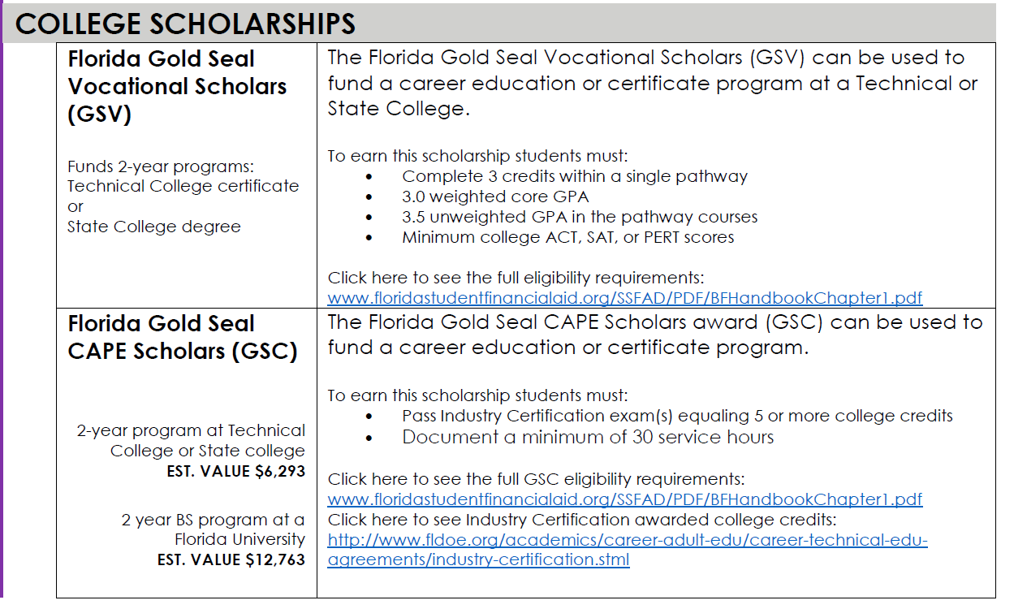
The Benefits Of Completing Your Cape Program Track

Slide 12
PLEASE CONTACT ME
Jonell T. Studstill
Career Success Coach/Magnet Coordinator
754-323-1372
jonell.studstill@browardschools.com
www.browardschools1.com/miramarhigh
“Our greatest weakness lies in giving up. The most certain way to succeed is always to try one more time.” -Thomas A. Edison

